Slide 1

Ensuring high quality in safeguarding Cultural Heritage_
The vital importance of protecting the title and regulating the professions of Conservation-restoration in Europe
E.C.C.O. & ACAWA
17th May 2022
Acropolis Museum
Athens, Greece

Slide 2
CHARTER, an opportunity for visibility and recognition: The professional role and competences of the conservator-restorer in Europe
WP2 – Strategic analysis of Cultural Heritage competences and occupational profiles
Leaders - E.C.C.O. and ICOMOS

Slide 3

CHARTER, an opportunity for visibility and recognition:
The professional role and competences of the conservator-restorer in Europe
E.C.C.O. Strategic Plan 2015
Our mission
To organize, develop and promote, on a practical, scientific and cultural level, the profession of the Conservator-Restorer.
To set standards and regulate practice at European level and enhance communication between and mobility of professionals.
To strengthen the role and responsibilities of the Conservator-Restorer in relation to others in safeguarding cultural heritage.
E.C.C.O. & ACAWA, 17th May 2022, Acropolis Museum

Slide 4
CHARTER, an opportunity for visibility and recognition:
The professional role and competences of the conservator-restorer in Europe
E.C.C.O. Strategic Plan 2015
Our Goals
Conservator-restorer’s Role in safeguarding cultural heritage and our relationship with the other professions
Quality build on an ethical approach that ensures a consistently high standard of work and its results, achieved in an accountable manner
Open Communication towards our member organisations, affiliated organisations, European governmental bodies and the broader community. Advocacy of our goals can only be effective when we have a high level of visibility.
Greater Mobility is achieved via the mutual recognition of qualifications of discrete competences
Legal frameworks and European directives impact on the Conservator-Restorers’ profession, including the legal obligations, towards cultural heritage and in its professional practice
Guidance as a proactive approach in giving advice and in developing tools and recommendations to the benefit of E.C.C.O.’s member organisations.
E.C.C.O. & ACAWA, 17th May 2022, Acropolis Museum

Slide 5
CHARTER, an opportunity for visibility and recognition:
The professional role and competences of the conservator-restorer in Europe
E.C.C.O. Strategic Plan 2015
Implementation strands/projects
Competence Framework enables standardization for the required competences to access professional practice as a Conservator-Restorer
Legislating for the Conservator-Restorer within Europe aims to positively influence legal frameworks at national level by our knowledge of EU Directives and recommendations
Extending the Network to advocacy for Conservator-Restorers promoting our role in the cultural heritage sector
Mutual recognition of qualification between member organisations through the recognition in members statutes, of the competence framework as a criteria for membership
Memoranda of Understanding continue to build relationships in order to work together towards specific objectives
Effective representation continue to meet national and EU political bodies and organisations
E.C.C.O. & ACAWA, 17th May 2022, Acropolis Museum

Slide 6
CHARTER, an opportunity for visibility and recognition:
The professional role and competences of the conservator-restorer in Europe
CHARTER – A Blueprint for the Cultural Heritage sector
Blueprints are structural policy making project for cooperation on skills in specific sectors. Under the blueprint, stakeholders work together in sector-specific partnerships, called alliances for sectorial cooperation for skills, which develop and implement strategies to address skills gaps in these sectors.
They will address skills shortages and unemployment by:
- gathering information for the European skills panorama
- developing a sector skills strategy
- developing occupational profiles, vocational programs and qualifications
- designing a long term action plan to be rolled out at the national and regional levels
Promoting the use of EU tools such as:
- the European qualifications framework (EQF)
- European skills, competences, qualifications and occupations (ESCO)
- Europass
- the European credit system for vocational education and training (ECVET)
- the European quality assurance in vocational education and training (EQAVET)
https://ec.europa.eu/social/main.jsp?catId=1415&langId=en
E.C.C.O. & ACAWA, 17th May 2022, Acropolis Museum

Slide 7
CHARTER, an opportunity for visibility and recognition:
The professional role and competences of the conservator-restorer in Europe
CHARTER – A Blueprint for the Cultural Heritage sector
AIMS to
Clarify occupational profiles to support the education system
Identify curricula and learning outcomes enabling responsive education & training programs for future heritage skills needs
Drat a new landscape for heritage professions allowing statistical visibility and economic accountability
Draft samples for occupational profiles and VET programs
Draft a transferable methodology for a skills strategy for the heritage sector
Draft Policy Recommendations at European level
E.C.C.O. & ACAWA, 17th May 2022, Acropolis Museum

Slide 8
CHARTER, an opportunity for visibility and recognition:
The professional role and competences of the conservator-restorer in Europe
CHARTER – A Blueprint for the Cultural Heritage sector
Goals
WP2 – Strategic analysis of Cultural Heritage Competences and occupational profiles
WP3 – Vocational Education and Training (VET) and beyond
WP4 – Sector Integrated Dynamics
WP5 – Alliances, Sustainable Strategies and Policy recommendations
Some FINAL OUTCOMES
Samples of occupational profiles and recommendations for the updating of the European and national frameworks for competences, qualifications and occupational profiles
Training content and recommendations for E&T and VET systems (both initial and continuing training)
Skills Strategy for re-skilling and up-skilling the workforce in the Cultural Heritage sector
E.C.C.O. & ACAWA, 17th May 2022, Acropolis Museum

Slide 9
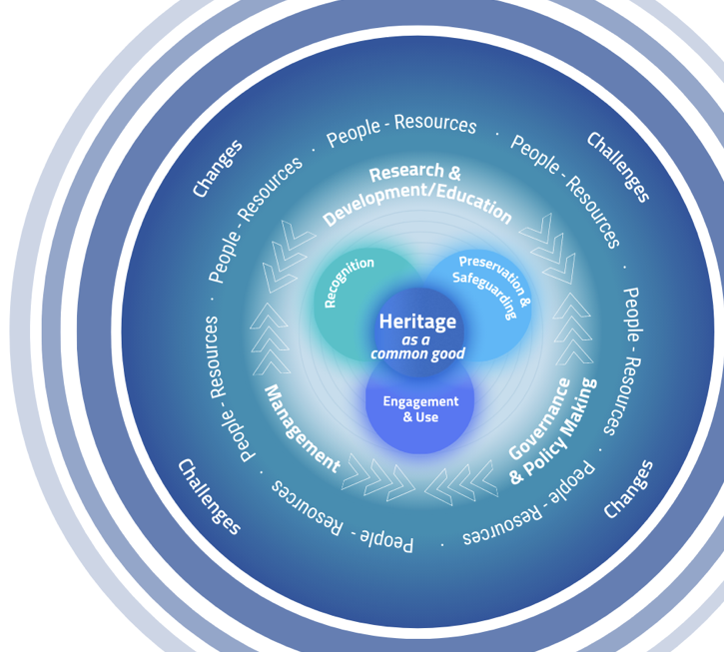
T2.2. CHARTER model to describe the cultural heritage sector
CHARTER, an opportunity for visibility and recognition:
The professional role and competences of the conservator-restorer in Europe
- 6 Functions describing the cultural heritage sector clustering activities
- All Functions are essential to realise cultural heritage potential as a driving force in sustainable social and economic development
- Soft focus of the image expresses the interrelationship of all its parts and the dynamics of the ecosystem cyclical nature
E.C.C.O. & ACAWA, 17th May 2022, Acropolis Museum

Slide 10
T2.2. CHARTER model to describe the cultural heritage sector
CHARTER, an opportunity for visibility and recognition:
The professional role and competences of the conservator-restorer in Europe
Conservator-restorer
E.C.C.O. & ACAWA, 17th May 2022, Acropolis Museum
Notes:
This leads to a specific occupational profile, built on the basis of our comptence framework
This leads to the visibility within frameowrks such as ISCO as well ESCO

Slide 11
CHARTER, an opportunity for visibility and recognition:
The professional role and competences of the conservator-restorer in Europe
E.C.C.O. Strategic Plan 2015 and CHARTER activities
Competence Framework enables standardization for the required competences to access professional practice as a Conservator-Restorer WP2
Legislating for the Conservator-Restorer within Europe aims to positively influence legal frameworks at national level by our knowledge of EU Directives and recommendations WP2 and WP5
Extending the Network to advocacy for Conservator-Restorers promoting our role in the cultural heritage sector All WP
Mutual recognition of qualification between member organisations through the recognition in members statutes, of the competence framework as a criteria for membership WP2, WP3 and WP4
Memoranda of Understanding continue to build relationships in order to work together towards specific objectives All WP
Effective representation continue to meet national and EU political bodies and organisations ALL WP
E.C.C.O. & ACAWA, 17th May 2022, Acropolis Museum

Slide 12
CHARTER, an opportunity for visibility and recognition:
The professional role and competences of the conservator-restorer in Europe
E.C.C.O. outcomes and legacy of CHARTER
Competences profile for the conservator-restorer (sample of occupational profile)
Discrete curricula and learning outcomes, enabling responsive education & training programs for future heritage skills needs
A transferable methodology for a skills strategy for conservation-restoration
A Policy Recommendations at European level
E.C.C.O. & ACAWA, 17th May 2022, Acropolis Museum

Slide 13
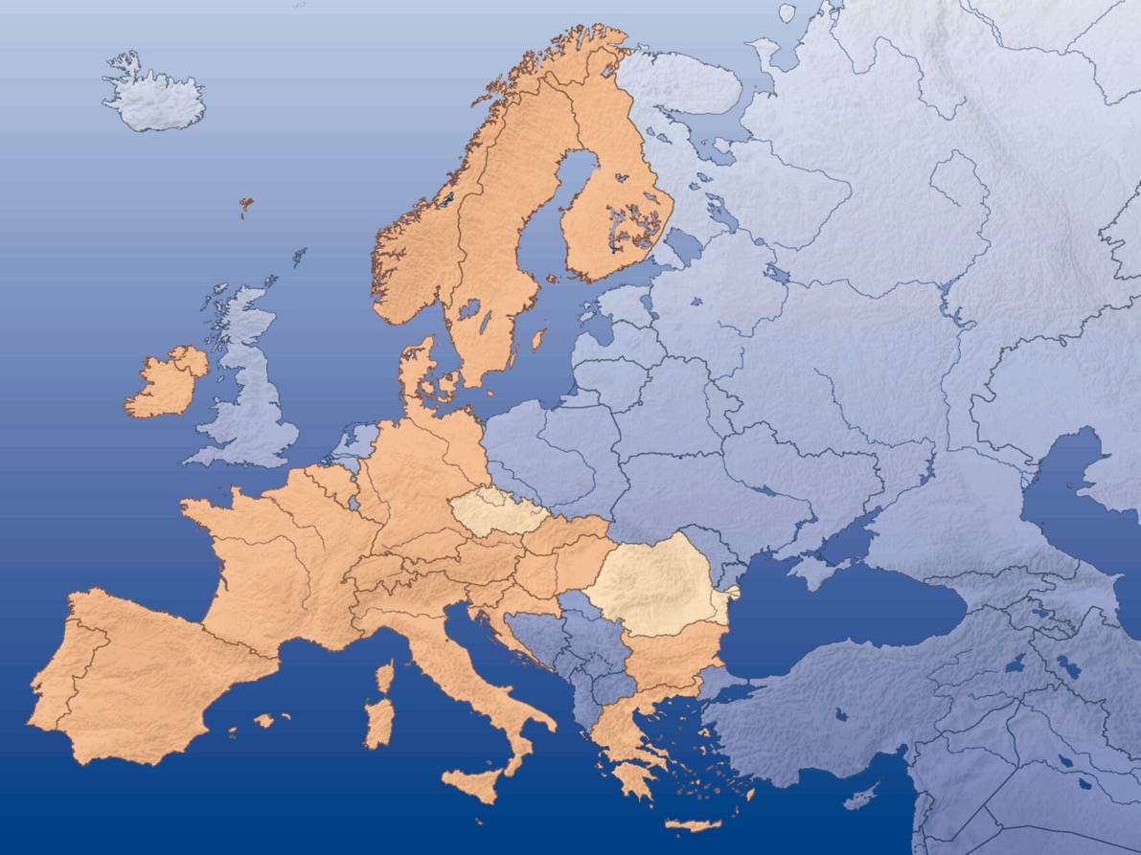
Ensuring high quality in safeguarding Cultural Heritage_
The vital importance of protecting the title and regulating the professions of Conservation-restoration in Europe
ACAWA & E.C.C.O.
Thank you!
E.C.C.O. & ACAWA, 17th May 2022, Acropolis Museum

